Slide 1
Clarify on error condition
Submit prompt
Checking condition
Expected behaviour
Exceeded input limit?
Error on exceeding input token limit
(e.g. 32,000 tokens for 4o)
Do not allow user to submit prompt unless trim down
Implemented
Internal processing
Individual responses against input limit
(e.g., 32,000 tokens for 4o?)
Do not allow follow up question, ask user to start a new convo.
Exceeded history limit?
Aggregate against history token limit
(e.g., 92,000 tokens for 4o?)
Refine msg.
Present output
Exceeded output & history limit?
Error on exceeding output token limit
(e.g., 4,000 tokens for 4o)
Truncated responses with msg.
Implemented
Error on exceeding overall(?) context limit?
(e.g., 128,000 tokens for 4o?)
Currently no error handling?
To develop

Slide 2
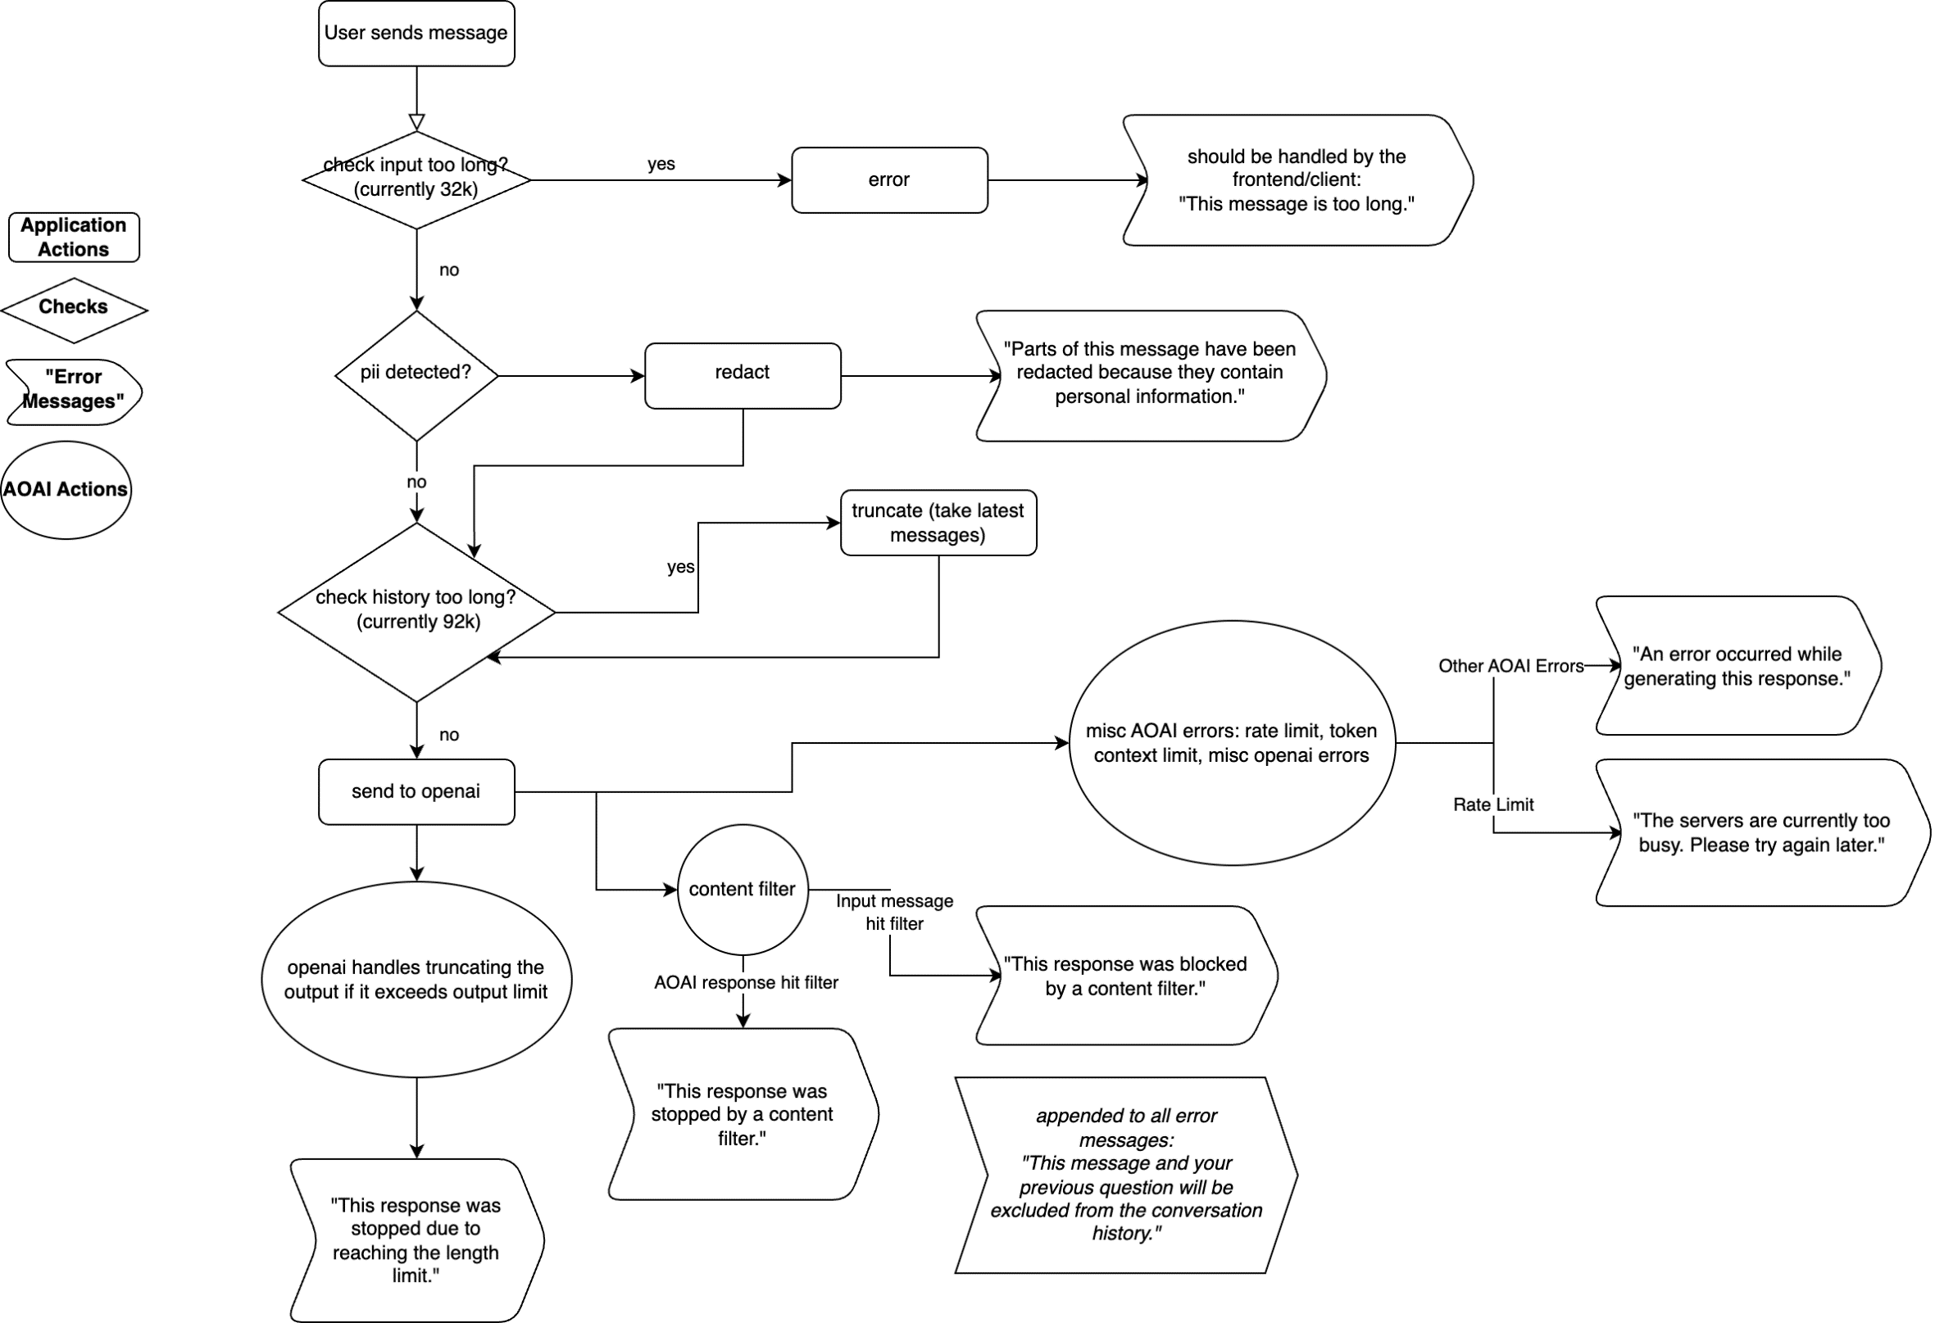
Normal Flow

Slide 3
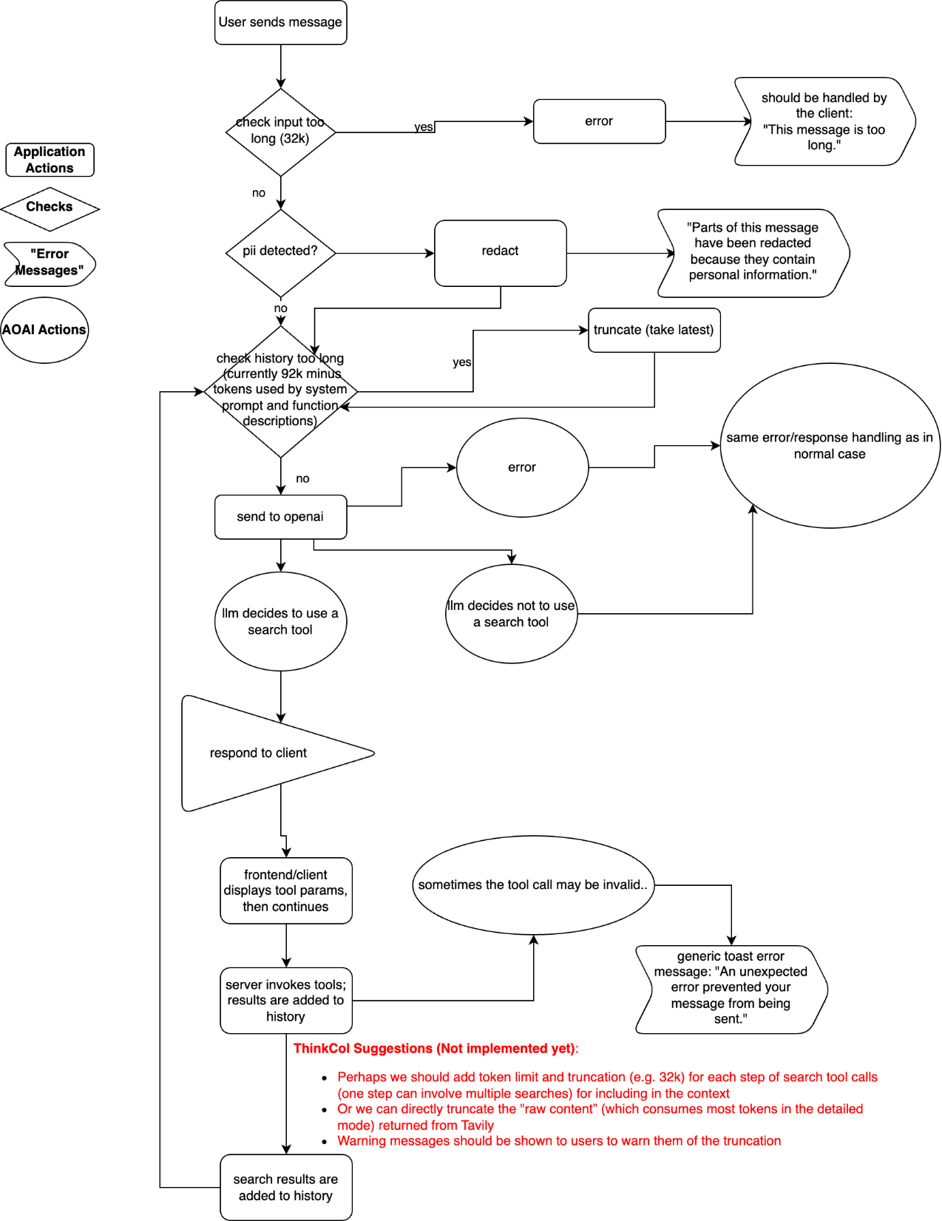
Tavily Search Flow

Slide 4
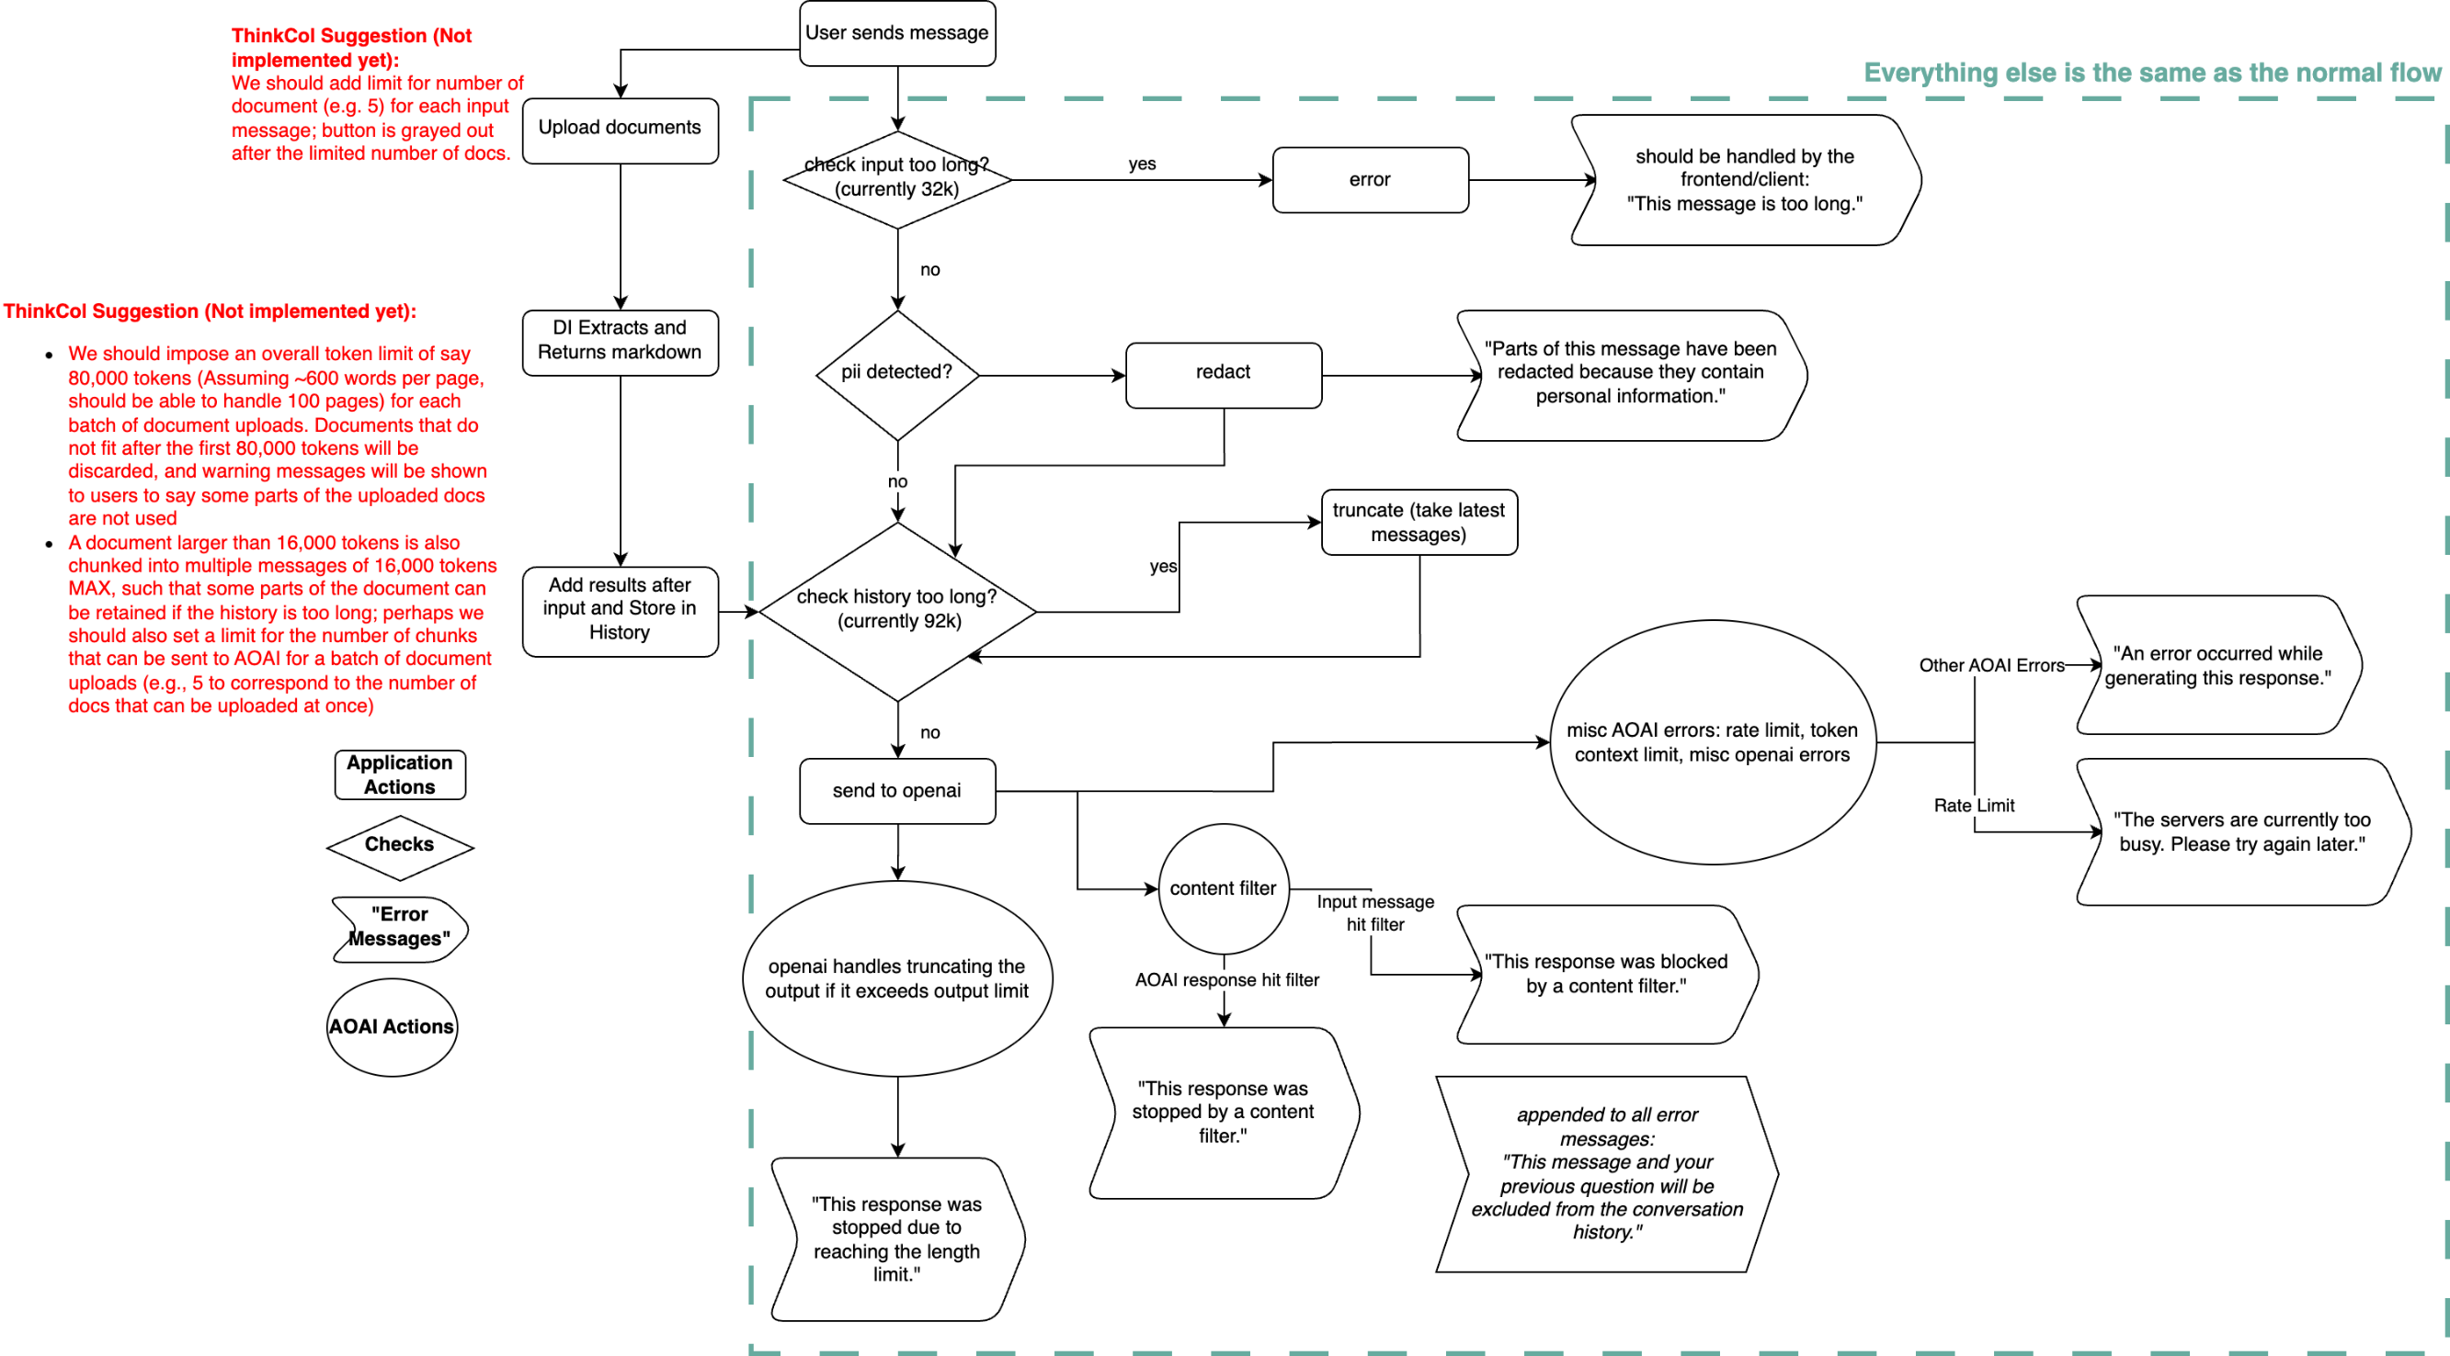
Document Intelligence Flow

